Slide 1
DSC Re-Activation Campaign Project Predictive Models
Justine Deleval, Daniela Tuiran, Dafni Krystallidou

Slide 2
Project definition
Using historical data from past reactivation campaigns, we want to predict which donors will be more likely to donate more than 35 € for the DSC re-activation campaign.
This model will be used to support the decision-making process:
How many donors need to be reached to gain the maximum profit?

Slide 3


Timeline
Past
Now
INFO
TARGET
INFO
TARGET
11/04/2013
15/01/2014
Data from donors & gifts data sets were used
Only included data before April 11th, 2013
Target Period: 11/04/2013 - 15/01/2014

Slide 4
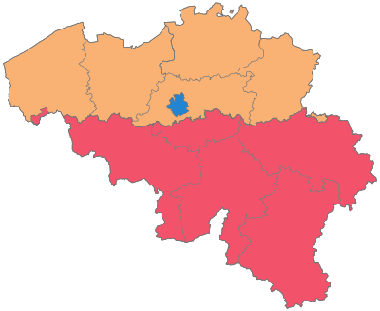
Variable Creation
Continuous Variables
Sum_donated : sum amount donated
Avg_donated : mean amount donated
Min_donated : minimum amount donated
Max_donated : maximum amount donated
Recency : time elapsed between last donation and the start of the target period (in days)
Dummy Variables
Language : 0: Non-French , 1: French
Gender: 5 levels: C, F, S, M, U
Location: split into 3 Belgian regions based on zipcode
Flanders
Brussels
Wallonia
per
Donor Id

Slide 5
Model building
Target Definition: binary classification
If donated > 35 € then 1
If donated < 35 € then 0
Train dataset: Campaign 2013
34,917 observations
Target incidence: 0.0059 / (206 targets)
Test dataset: Campaign 2014
25,645 observations
Target incidence: 0.0148 /(379 targets)

Slide 6
Feature Selection Algorithm
Forward stepwise
Rencency
Language
U
S
F
sum_donated
nbrs_donations
Brussels
C
M
Wallonia
Flanders
max_donated
min_donated
avg_donations

Slide 7
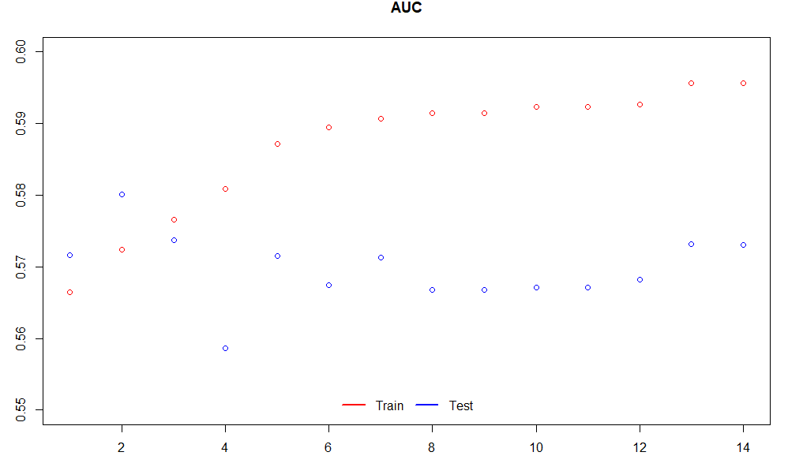
Results of AUC
AUC train: 0.59
AUC test: 0.57
The result of the AUC curve shows that the variable "S" at index 4 is decreasing the performance of the test curve
We decided to take out the variables "U", "S","C" (related to the gender category) and rerun the model

Slide 8
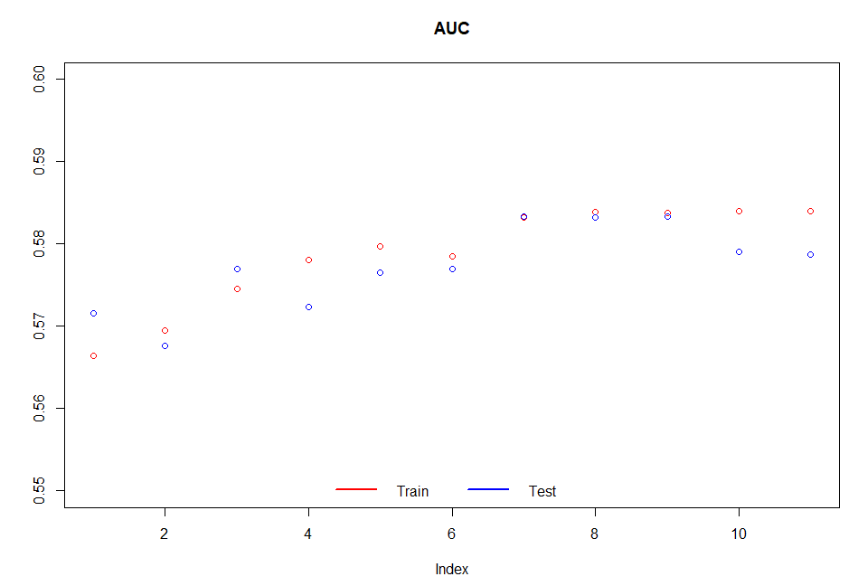
Final Model – List of Variables
Finally, we included 8 variables
The test and train are performing similarly
AUC train: 0.5832
AUC test: 0.5833
There is no overtraining, because the test AUC is slightly higher than the train AUC

Slide 9
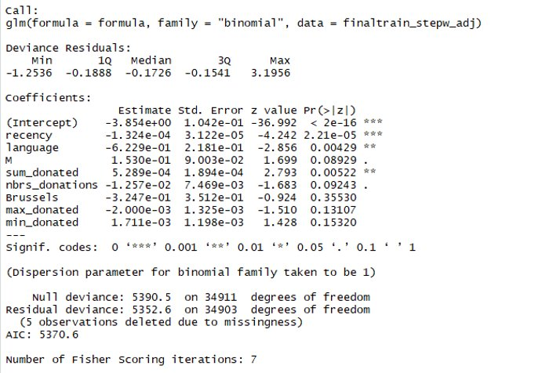
Final 8 Variables Selected
Rencency
Language
sum_donated
nbrs_donations
Brussels
max_donated
min_donated
Male
The highest significance values are recency p<0.001, language and sum donated p< 0.01, male and numbers of donation p< 0.05

Slide 10
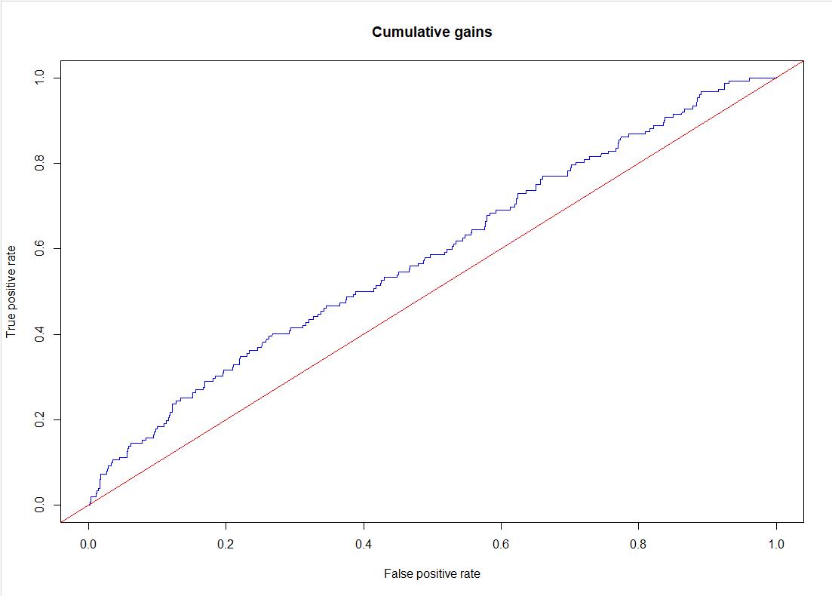
Evaluation -Cumulative Gains
Slightly better performance than random

Slide 11
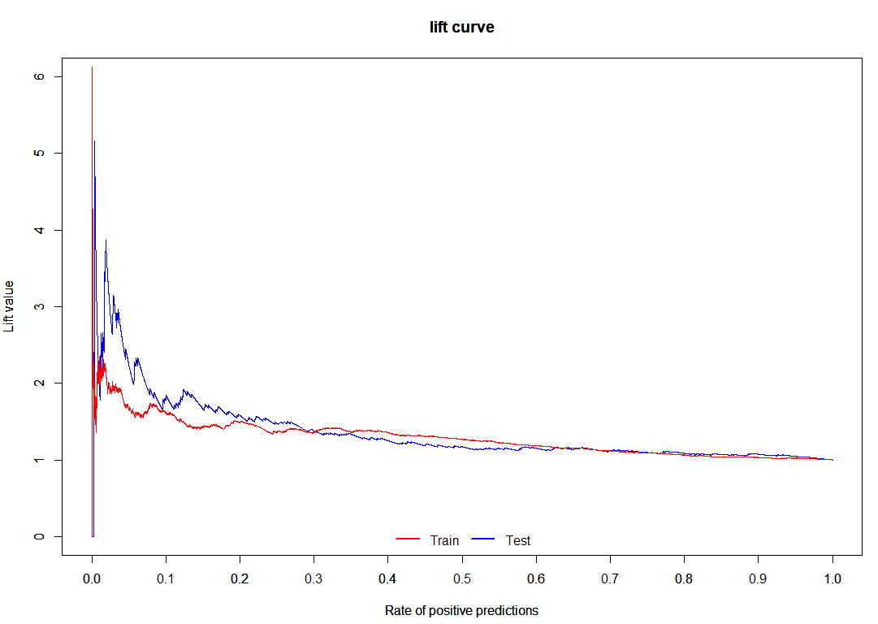
Evaluation -Lift Curve
Lift curve --> better model performance for the test than the target dataset.
Trend also reflected in AUC curves.
Train Target Incidence : 0.0059
Test Target Incidence : 0.0148
Overall the model would be better if we had stratified the target
In order to include equal percentages of targets in both train and target data sets.

Slide 12
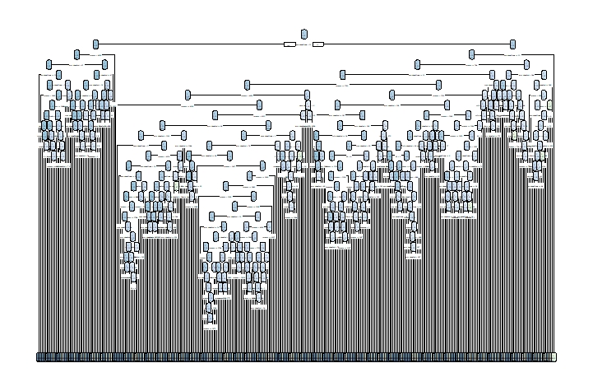
Alternative Model – Decision Tree
Decision Tree
Output contained only one root node.
We had to decrease : minsplit and minbucket to get a result.
The result was not very easily interpretable- many nodes
Possible reason: too many observations with a low target incidence
N= 35,000
Notes:
Minsplit: minimum no of observations that must exist in a node in order for a split to be performed
Minbucket: the minimum number of observations in any terminal node

Slide 13
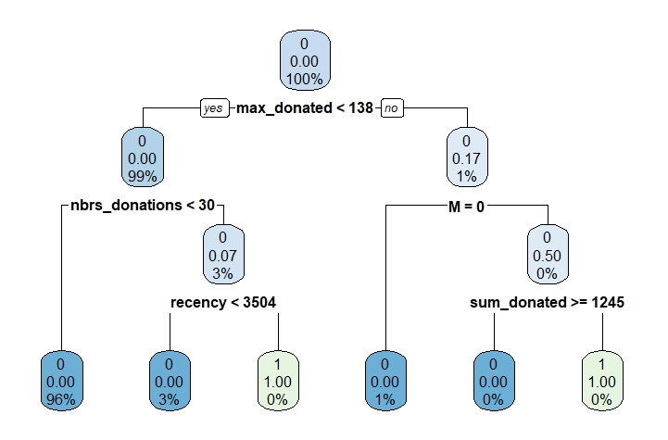
Decision Tree Example
N= 500

Slide 14
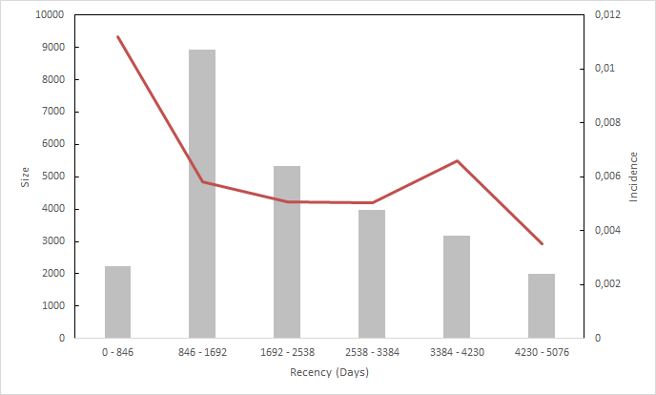
Interpretation of Variables – Recency
The more time elapsed(recency) between the last donation and start of target period, the less likely the donor will donate
Notes:
If the donor speaks French, he/she will be more likely to donate
The more time elapsed(recency) between the last donations, the less likely the donor will donate
Male donors you are more likely to donate
The bigger the sum donated by the donor, the more likely he/she will donate
With higher frequency of donation, the less likely the donor will donate
Donors from Brussels are less likely to donate
With higher maximum amount donated, the less likely the donor will donate again
With higher minimum amount donated, the more likely the donor will donate

Slide 15
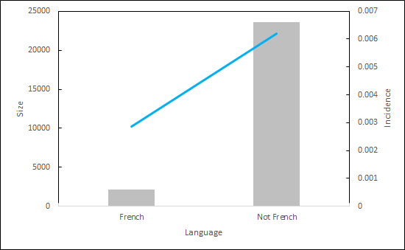
Interpretation of Variables – Language
If the donor does not speak French, he/she will be more likely to donate
Notes:
If the donor does not speak French, he/she will be more likely to donate
The more time elapsed(recency) between the last donations, the less likely the donor will donate
Male donors you are more likely to donate
The bigger the sum donated by the donor, the more likely he/she will donate
With higher frequency of donation, the less likely the donor will donate
Donors from Brussels are less likely to donate
With higher maximum amount donated, the less likely the donor will donate again
With higher minimum amount donated, the more likely the donor will donate

Slide 16
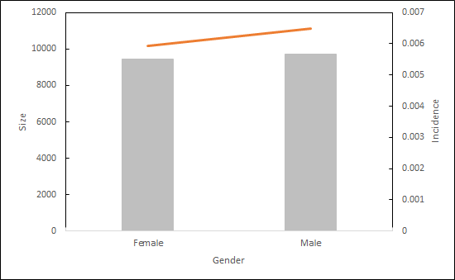
Interpretation of Variables – Gender
Male donors are more likely to donate
Notes:
If the donor does not speak French, he/she will be more likely to donate
The more time elapsed(recency) between the last donations, the less likely the donor will donate
Male donors you are more likely to donate
The bigger the sum donated by the donor, the more likely he/she will donate
With higher frequency of donation, the less likely the donor will donate
Donors from Brussels are less likely to donate
With higher maximum amount donated, the less likely the donor will donate again
With higher minimum amount donated, the more likely the donor will donate

Slide 17
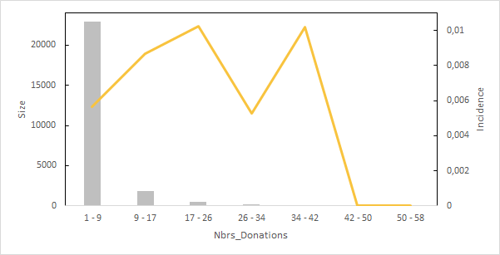
Interpretation of Variables – Number of Donations
Donors that donated more than 42 times are less likely to donate
Notes:
Outliers slicing

Slide 18
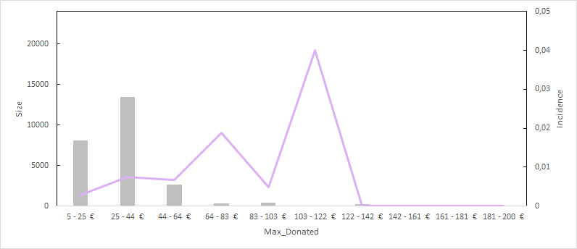
Interpretation of Variables – Maximum donated
Donors with a maximum amount donated greater than 142€ are less likely to donate again
Notes:
Outliers slicing

Slide 19
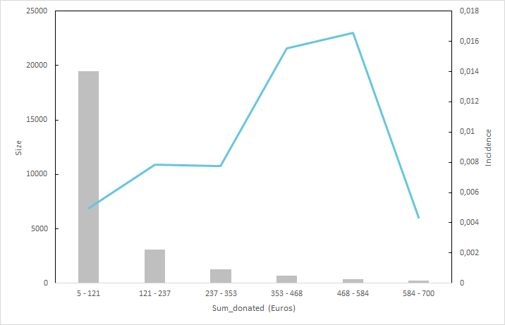
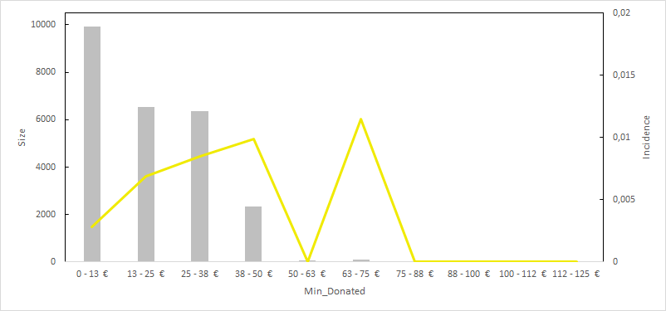
Interpretation of Variables – Sum & Minimum Donations
The largest the sum donated by a donor, the more likely he/she will donate
Donors with higher minimum amount donated are more likely to donate
Notes:
Outliers slicing

Slide 20
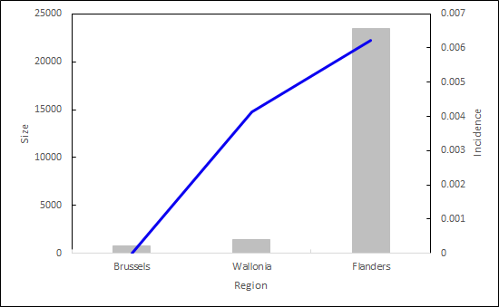
Interpretation of Variables – Region
Donors from Brussels are less likely to donate
Notes:
If the donor does not speak French, he/she will be more likely to donate
The more time elapsed(recency) between the last donations, the less likely the donor will donate
Male donors you are more likely to donate
The bigger the sum donated by the donor, the more likely he/she will donate
With higher frequency of donation, the less likely the donor will donate
Donors from Brussels are less likely to donate
With higher maximum amount donated, the less likely the donor will donate again
With higher minimum amount donated, the more likely the donor will donate

Slide 21
Business Case
What percentage of the donor population should we reach to get the maximum possible profit from our reactivation campaigns?
Target Incidence: average target incidence of the test & training datasets
Reward per Target: mean amount donated by each target in the test and training datasets
Population size: total number of donors in the Donors database
Population Size | 44,691
Target incidence | 1.040%
Reward per target | 47.00 €
Cost per person | 0.50 €

Slide 22
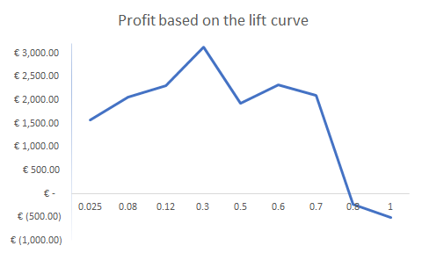
Guiding our business decision
Tool: Lift Graph
We calculated the profits of our campaign based on the lift curve
Expected profits were calculated as a function of percentage of donors selected
Selected the percentage yielding maximum profit
Maximum profit
3,126 €

Slide 23
Business Case - Solution
DSC will make maximum profit by sending letters to 30% of the candidate donors
Based on our model, maximum profits will be generated (3,126 €) by addressing 30% of the donors.
Selected Donors | 13407
Percentage Selected | 30%
Cost | 6,704 €
Reward | 9,830 €
Profit | 3,126 €

Slide 24

THANK YOU!!!

